Slide 1

Python Bytes
Week 4 - Loops + Lists
Happy Halloween!

Slide 2
TABLE OF CONTENTS
01
Quick Refresher
04
While Loops
02
05
Last Week Recap
Break + Continue
03
06
For Loops
Lists

Slide 3

01
Quick Refresher
1. print(“print(\”Py\n3\”)”) output?
A.
Py
3
B.
print(\”Py\n3\”)
C.
print(“Py
3”)
D.
\”Py\n3\”

Slide 4
01
Quick Refresher
2. print(f”Alex has {2+3*6} apples”) output
A.
TypeError - cannot concatenate “str” and “int” objects
B.
Alex has {2+3*6} apples
C.
Alex has 30 apples
D.
Alex has 20 apples

Slide 5
01
Quick Refresher
3. What is this equal to: (6 // 4) ** (7 % 4)
A.
3.375
B.
1
C.
4.5
D.
3

Slide 6
01
Quick Refresher
4. What is a boolean?
A.
A type of Polish broth
B.
Gets an input from the user via a website
C.
Gets Python to make a decision
D.
Creates a variable

Slide 7
02
Last Week Recap
Worked on and did shared of our “Choose Your Own Adventure” Project

Slide 8

03
For Loops

Slide 9
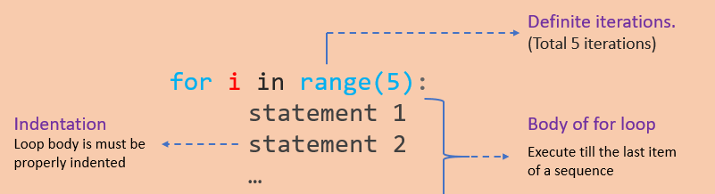
03
For Loops
A For Loop is a statement that can be used to repeat a block of code a certain number of times
It can also iterate over data types like strings and lists – we’ll talk about this later!

Slide 10

04
While Loops

Slide 11
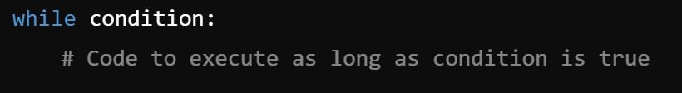
04
While Loops
A While Loop is a control flow statement that repeatedly executes a block of code as long as a specified condition remains true. (A)
It can also use boolean variables in its condition

Slide 12

Break & Continue
Statements
05

Slide 13
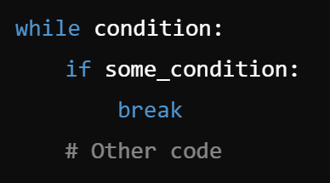
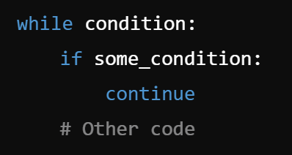
05
Break & Continue
Break Statement: It exits or “breaks” a loop when it is used. It’s usually inside a conditional statement inside the loop.
Continue Statement: Skips rest of the code inside the loop and goes to the next iteration when used. Also usually inside a conditional statement.

Slide 14
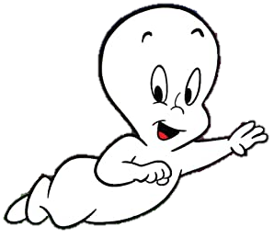
08
Billy Saves Up - Coding Challenge
The Situation: Billy decides spending all his money on halloween candy isn’t the smartest thing to do, so he decides to start saving up money. His parents, happy about Billy’s newfound maturity, decides to give him a dollar every day. And Casper, being the friendly ghost he is, decide to also double his money every day. How many days will it take for Billy to become a billionaire?
Your Task: While it is possible to do this mathematically, we want you to use your new skills of for loops and while loops to figure out how many days it’ll take!

Slide 15
Coding Time!
Open up VSCode and let's start coding:
Loops!

Slide 16

06
Lists

Slide 17
06
Lists
A list is a collection of items which can be stored in a single variable
Lists have a defined order, meaning items can be accessed using indexes
Basic Syntax:
Indexes: 0 1 2
-3 -2 -1

Slide 18
06
Lists Operations
Accessing Items:
  list_name[index#]
Adding Items:
  list_name.append(item)
  Adds items to the end of the list
Slicing the List:
  list_name[starting index#: ending index#]
Inserting Items:
  list_name.insert(index#, item)
Removing Items:
  list_name.remove(item)
  Removes the first occurrence of the item

Slide 19
06
Lists Operations
Getting the list’s length:
  len(list_name)
Sorting the list:
  list_name.sort()
Reversing the order of the list:
  list_name.reverse()

Slide 20
Coding Time!
Open up VSCode and let's start coding:
Lists!

Slide 21
07
Quick Recap
For Loops: Something that iterates through a block of code or a string certain amount of times. (Also can iterate through a list, but that’s for another day)
While Loops: A loop that iterates through a block of code when the condition is true.
Break and Continue Statements: Breaks stops the loop from working, while continue skips to the next iteration of the loop
Lists: Is a data structure which can order a set of data and can be accessed via indexes

Slide 22
08
Coding the Fibonacci Sequence
The Fibonacci Sequence follows the rule that each number is equal to the sum of the preceding two numbers, with the first two numbers starting at 0 and 1.
Your Task:
Use your new gained skills of for loops and while loops (you decide which one to use), lists, and old skills (maybe variables?) to print the first 15 numbers in the fibonacci sequence!

Slide 23
Thats It!
Remember to clean up and stack chairs!

